Slide 1
The Role Of Sports Development & Our Relationship with BANG
John McBay- Sports Development Manager

Slide 2
Live Borders Culture and Leisure Services
Live Borders, an integrated trust providing culture and leisure services on our behalf, was established on 1 April 2016.
The organisation employs 520 full and part time employees
Services delivered by Live Borders include:
10 Community Centres & 13 Halls & Venues
13 Libraries and 1 Archive Facility at the Heriatge Hub in Hawick
13 Museums and Galleries / Harestanes Visitor Centre/Heart of Hawick
Sports Facilities
6 Swimming Pools
Tri Fitness in Galashiels & Tweedbank Outdoor Sports Centre
Netherdale Arena 3G & Hawick 3G & Selkirk 2G
Community Services – Play, Sports Development, Active Schools, Health Development & Arts Development

Slide 3
What Is Sports Development
Our Mission Statement: To be a successful, sustainable business providing quality opportunities that inspire people by participating in physical activity sport and culture.
The sports development service has a clear focus to develop and support local clubs, volunteers, coaches and athletes to realise their full potential.
The key to any sports development service is the partnership approach through Scottish Governing Bodies, Clubsport Borders, Local Facilities, Public Sector Providers and the Voluntary Sector.
We do our very best to make sure the pathways, organisations
and funding are working together to create well rounded athletes
and efficient structures to support sport.

Slide 4
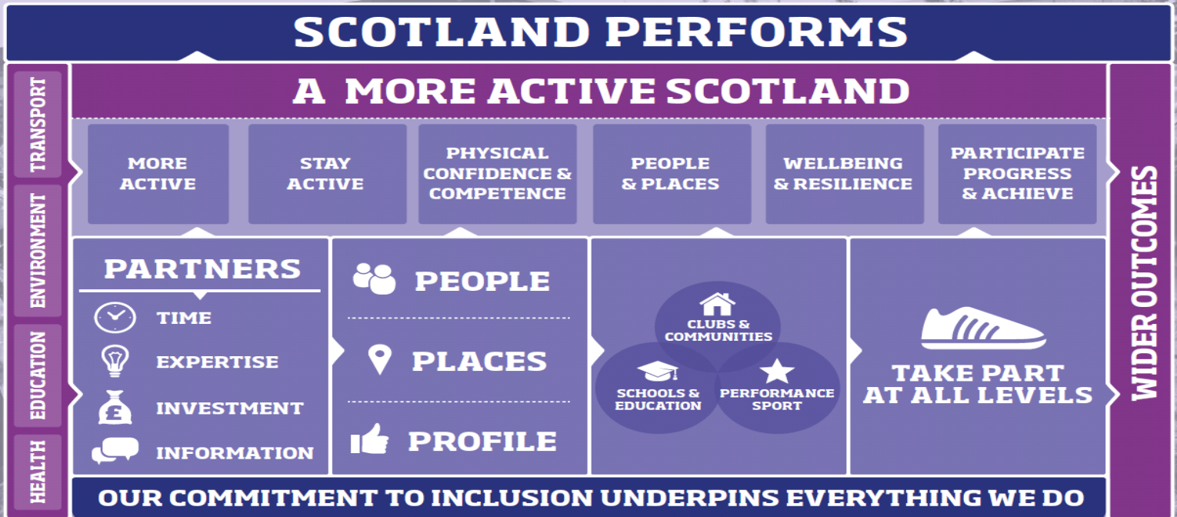

Slide 5
The Sporting Landscape
Within the Scottish Borders there are a number of partners who help us enormously to deliver on the BSLT key objectives.
Scottish Governing Bodies
Club Sport Network (formerly Sports Councils)
Community Sports Hubs
Borders Athlete Support Programme
Local Target Sports Development Groups
Scottish Borders Disability Sports Group
Sports Development Team have moved towards creating a structure to really make a difference to communities

Slide 6
Our Relationship with the Borders Additional Needs Group Our relationship with BANG is very special and unique Allows a very small sports service to deliver their services in a co-ordinated way. Allows the Development Officers to work with the parents and children at the same time. Allows Live Borders to benefit from Training Opportunities & On the Job Training Allows the Sports Development Service to provide a range of Opportunities to the Group that they did not have access to in the past. As we work with Clubs we can start to factor BANG

Slide 7
Thanks For Listening
For Further Information Contact jmcbay@Liveborders.org.uk

