Slide 1
Borders Additional Needs Group Silent Disco in partnership with Tweedbank Youth Club Dec 2017
Notes:
Introduce : BANG – Parent Led Charity Based in Scottish Borders working with families and young people with additional complex and rare conditions . Have a #BYG Over 11 years group since 2016
Tweedbank Youth Club -

Slide 2
We're having such fun !!!
Inclusion Disco for Young People with Additional Needs and Young Carers in Partnership with Tweedbank Youth Club December 2017
Notes:
BANG decided to run an Inclusive Disco for our Young people and their care givers and decided on Concept of a Silent Disco to embrace any sensory issues with young people with Autism and sensory processing disorders

Slide 3
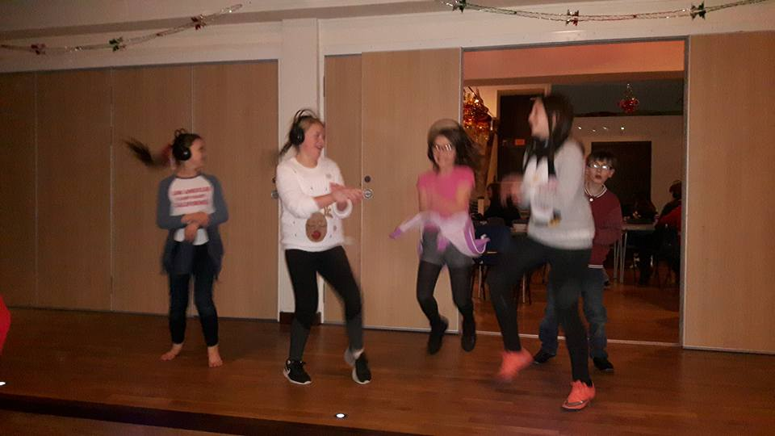
Notes:
Tweedbank Youth Club having fun !

Slide 4
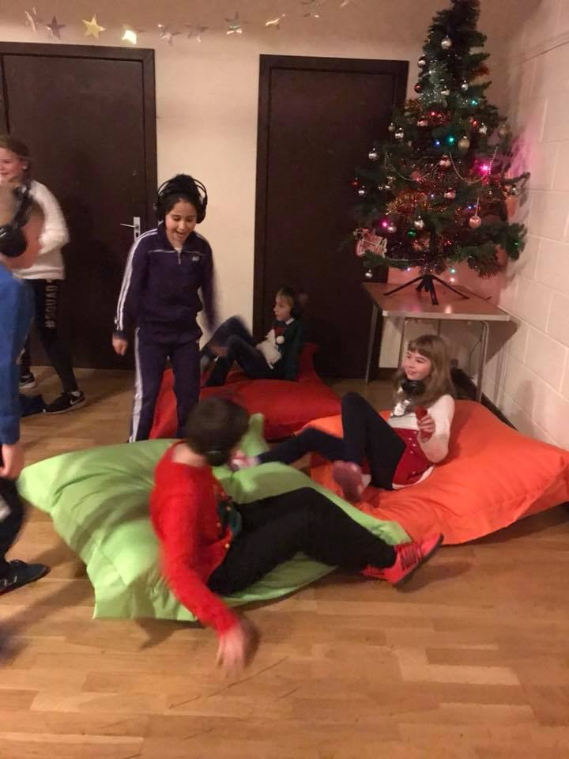
Notes:
We ensure at all our events there is a chill out area, and we purchased these amazing bean bags "

Slide 5
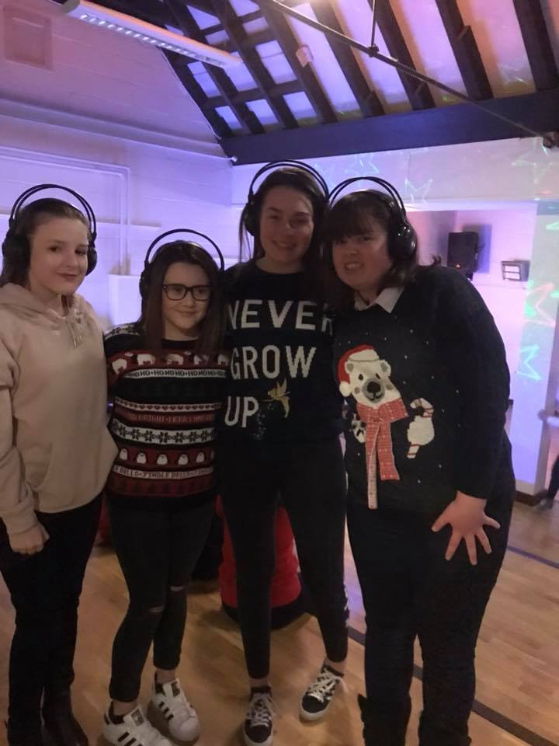
The Silent Disco was an amazing experience, it was a chance to make new friends and meet new people.
Lucy aged 11
Notes:
A wonderful quote from one of Tweedbank Youth Club Lucy Tait

Slide 6
Wonderful Moment when 2 friends shared a precious moment
#INCLUSION
At the disco there where 2 little boys called Denver and Leo. Leo and I were just playing and my little sister and a few of my friends had left their headphones down, I put my headphones on and Leo mimicked the move by picking up a pair and wearing them. He was trying on different sets with the different music and it looked like he was really enjoying it.
Lucy aged 11
Notes:
This is Lucy Story …. Lucy to read this out and discuss

Slide 7
Notes:
All the young people regardless of disabilities had fun

Slide 8
Notes:
Some of the dedicated volunteers at BANG and Tweedbank Youth Club

Slide 9
Notes:
The wheelchair picture captures the inclusion of our Silent Disco

Slide 10
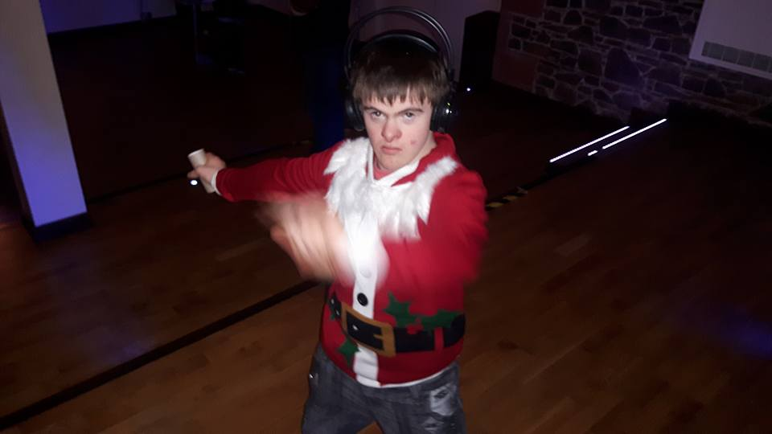
Notes:
One of BANG young people who lead the Dancing moves which Tweedbank Youth club young people really enjoyed !

Slide 11
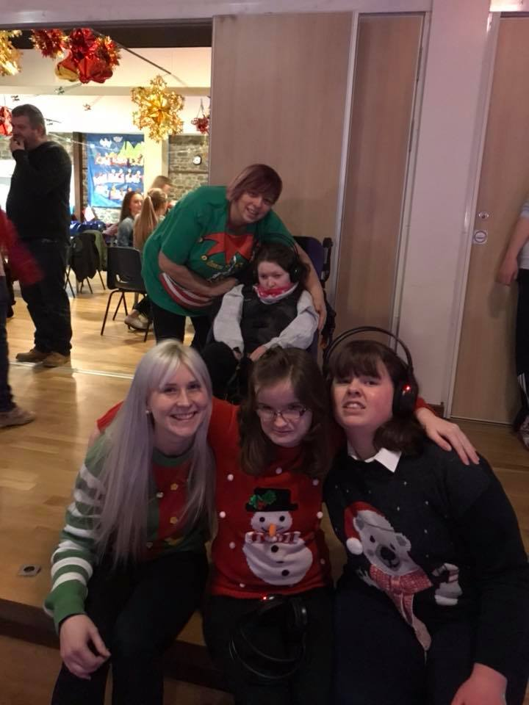
Notes:
Aberlour joined us on the night BANG work In true partnership with any organization that embraces the inclusion of our young people

Slide 12
Notes:
A relaxed Happy place to bring our young people together. Everything that happened on that night was spontaneous and organic. All we did was create the right environment …....

Slide 13
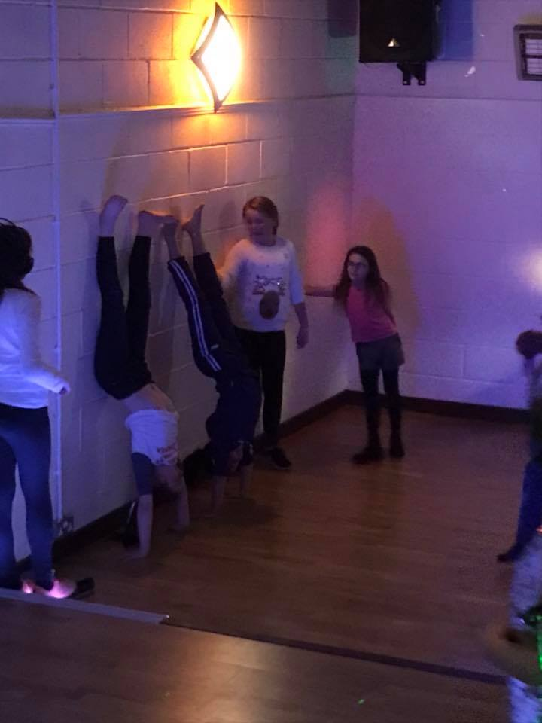
The Silent Disco was truly a great night
Lucy aged 11
Notes:
Final Quote from Lucy

Slide 15
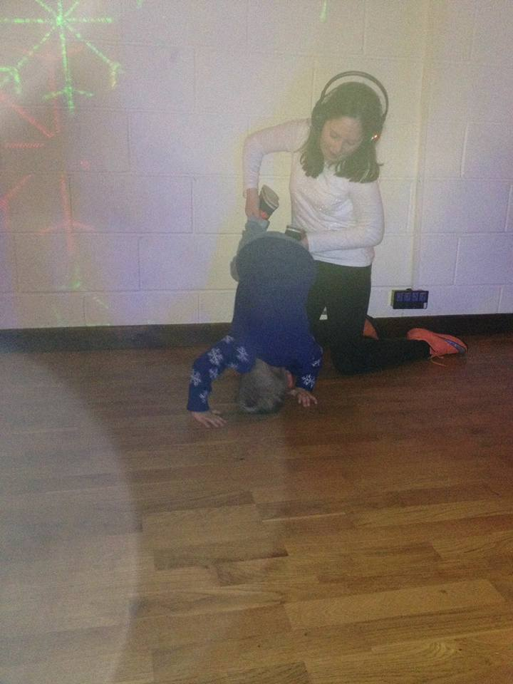
Thank You for Watching on behalf of all our Children at Borders Additional Needs Group and Tweedbank Youth Group
Notes:
BANG and Tweedbank Community Centre will be running another silent disco on Dec 7th 2018 this time with Neon Headphones to increase the sensory experience..... We pilot initiatives to be shared within he community if you require any further information please visit us at our stall
Thank you

