Slide 1



Children’s Rights in Education

Slide 2




assessment
as a process,
not an event
duty to determine
ASN & CSP
assessment
request
Assessment
views of child
views of parent
additional support needs
“disability”
“wellbeing”

Slide 3

“All children with additional support needs should be engaged in personal learning planning and for many this process will be sufficient to address their additional support needs.”
“An individualised educational programme describes in detail the nature of a child‘s or young person‘s additional support needs, the ways in which these are to be met, the learning outcomes to be achieved, and specifies what additional support is required…”
personal learning
planning
Co-ordinated
Support
Plan (CSP)
wellbeing
assessment
and plan
IEP
ASP
MASP
ILP
ISP
Child’s Plan

Slide 4


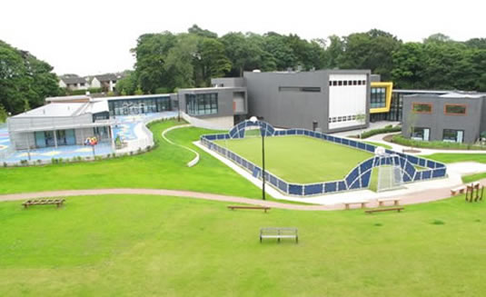

Placing Requests
Placing Requests
  out-of-area
  additional support needs
  independent schools
  alternative routes
Duty to comply with placing requests
Circumstances in which the duty does not apply
  Eg. Seriously detrimental to the continuity of the child’s education.
  The specified school is not suited to the age aptitude or ability
  of the child
  where the specified school is a special school, placing the child
  in the school would breach the presumption of mainstreaming

Slide 5




Transition

Slide 6


independent
adjudication
mediation
dispute resolution
complaints
(SPSO)

Slide 7





where
to get
HELP!

Slide 8
Cairn Legal
www.cairnlegal.co.uk
info@cairnlegal.co.uk
@CairnLegal

