Slide 1


First Step
4 Families
Project
Scottish Borders Parent Carer Forum
Stakeholders Consultation 2019

Slide 2
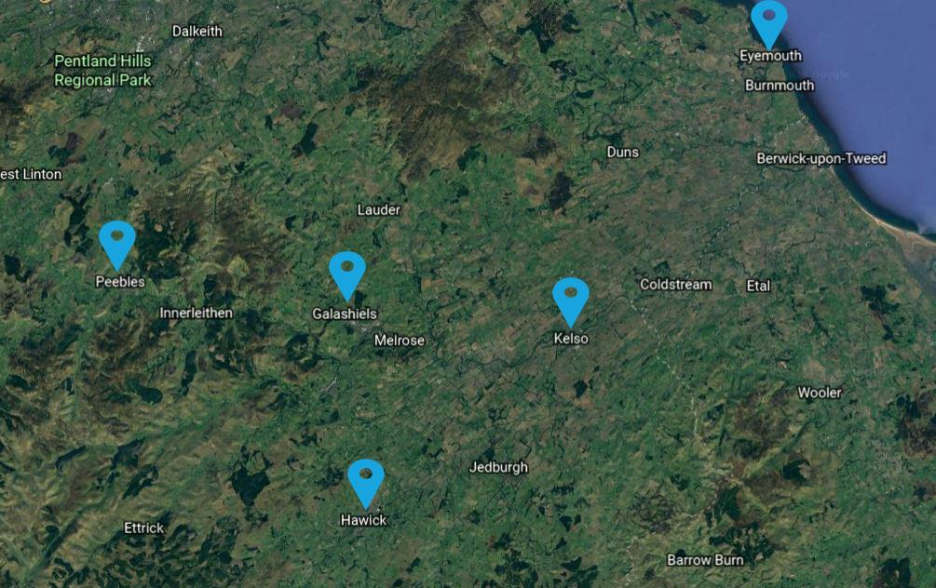
Project Locations
Kelso Abbey Row
Peebles Eastgate Theatre
Hawick Burnfoot Community
Langlee Community Centre
Eyemouth Community Centre
We engaged with 31 Parent Carers, Foster ASN Carers and proffesionals

Slide 3
Priority 1: Education
Training of needed / transition of employability / positive destinations.
Highlighted as the biggest area of concern in 4 localities by all parents.
Parent carers discussed their issues relating to; education, lack of insight into a child’s needs, lack of engagement and lack of involvement in co-producing child’s education care.
Significant needs to be provided in education especially within secondary schools.
Postive :
There was a willingness for parents to engage with educators

Slide 4

Priority 2: Social Opportunities
Need training for wider community and organisations, teenage transition into social life, more social and inclusive opportunities needed within our local communities.
Parents reported concerns regarding their children mental health due to social isolation evidence of self harming/ low self esteem 6 children .
There was a specific focus on lack of social inclusion on children aged 11 years to adulthood.
Limited engagement by Statutory services with grass roots charities

Slide 5
Priority 3: Impartial Advocacy Support
Post and pre-diagnosis
Clearer pathways of support for Parents
Impartial support - high need 27 parents
Informal advocacy as a significant need.
One of the main issues discussed by parents was on the challenge to advocate and coordinate the care of their child.
No identified parental involvement or engagement pathway model.
Large disconnect between statutory services and the relationship with parents in additional support needs
Impartial Advocacy volunteer led- unmet needs
Limited access to information, advice.

Slide 6
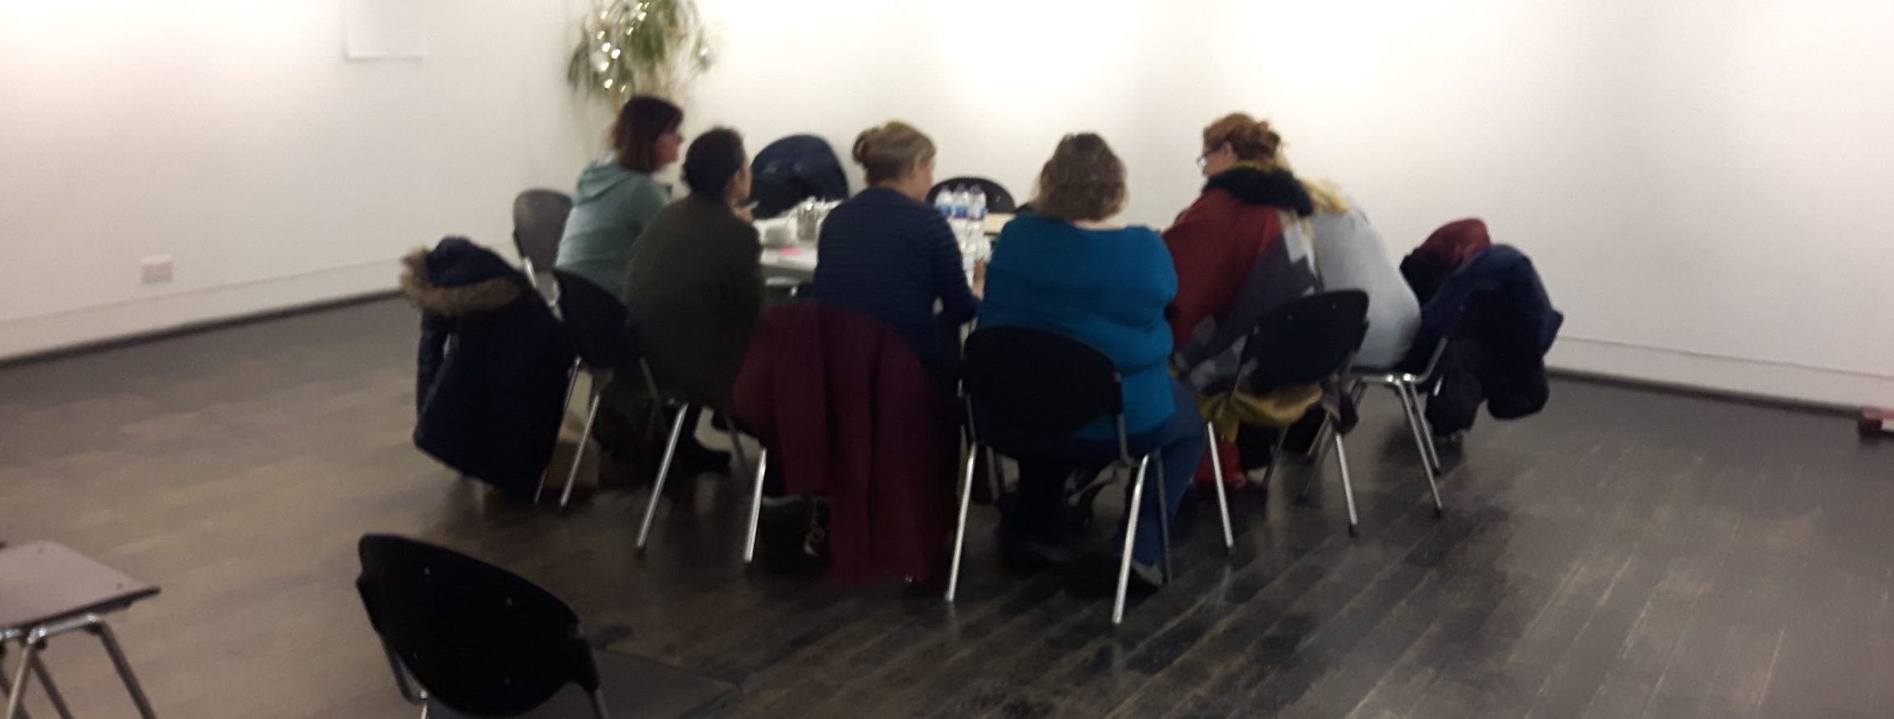
Impact on families
and what we aim to resolve
Parents mental health has been negatively impacted.- marginalised and disempowered
Children and young individuals mental health has been compromised long waiting lists.
Lack of holistic support for parents and families. Lack of jobs
Parents and organisations like BANG and MOfM are not being heard at a strategic level
Families feel dismissed in co-producing Pearson Centred planning around education, socialisation and care.

Slide 7
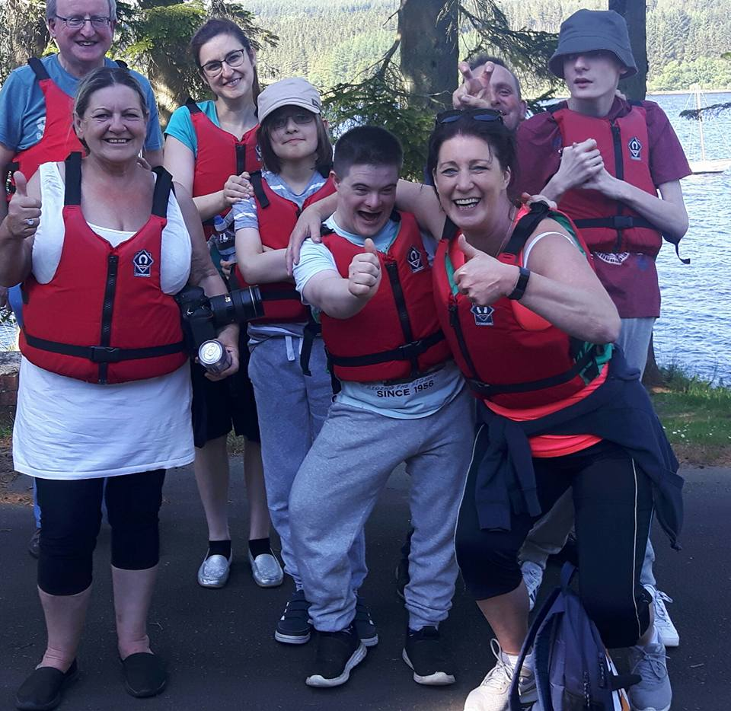
Impact : BANG SCIO
2019 = 60 families and 238 members here's a
SNAPSHOT of what we do !
• Youth Project / Young Transition Café launch autumn 2019
• Impartial advocacy 1-1 over 10 families since Feb 2019
• Archery Session peer support sport project = 18 Young people
• Positive destination/ work experience
• Cash for Xmas - 64 children
• Summer Respite project : 60 x 5 = 300 people over 5 weeks
• Stable Life project Young Carers
• Inclusion Silent Disco = 100 young people/youth club
• Social outings/ Saturday mornings/ music therapy
We are here and we care :-)

Slide 8
How do we focus on our 4 priorities?
Engage
Improve engagement with Local Authority, Health, Statutory Services and wider Third Sector. Improve engagement with Families
Inform
Inform parents and young people about local and national support services and organisations.One point of access
Include
Ensure all parent carers and young people are included in local decision making. Voice and representation
Support
Ensure parents and young people have direct access to supportive services locally and nationally.

Slide 9
How we aim to do this
Regional consulting voice/ Themed Networks / Strategic
Website of shared ASN dedicated resources /website
Transition program for age 14+ ASN youths and Youth Voice
Children and Family Early Intervention Projects including Respite/Social
Improved Engagement with parent Carers and Educators

Slide 10
First Step 4 Families working with key partners - BANG, MOfM, EPIC, Spectrum
Priority 1
Right support at the Rights Time
Early Intervention ProjectDedicated Outreach Service
Family Centered Holistic Approach
Signposting / connecting them to support
Resilient Workshop programme
Resource Tools
Priority 2
Transition to Employability 14 +
Community ASN Youth Cafe / Youth Voice
Social activities - opportunities
Hub and spoke model
Person centred journey to positive destination
Youth Voice / Resilience / employers

Slide 11

Each piece of the jigsaw
If you would hold a piece of the jigsaw, we are interested in hearing from you.

Slide 12
Thank you for your time.
Please leave your feedback and we look forward to working with you in the future.
Scottish Borders Parent Carer Forum - SB#PCF - A voice to engage parent carers
Borders Additional Needs Group SCIO in Partnership with First Step 4 Families C.I.C
Working together with Meeting of Minds, E.P.I.C, Spectrum Borders

